Slide 1
Verona Board of Education
Public Hearing
2016-2017 Budget
April 26, 2016

Slide 2
Budget Timeline
November 2015 | Administrative team identifies 2016-2017 budgetary needs
December 2015 | Building budgets submitted to Superintendent of Schools for review
Jan/Feb/Mar/Apr2016 | Board of Education Finance Committee meets regularly to review budget requests
March 22, 2016 | Board of Education public budget work session Adoption of preliminary 2016-2017 school budget
April 26, 2016 | Adoption of final public budget- Final Budget Presentation
April-June 2016 | Public presentations
November 2016 | School Board Election- Two seats up for re-election

Slide 3
What This Budget Buys
Staff
New staff in HBW to accommodate special education students
Increase in vocal and instrumental music at VHS
Innovative Programs/ Implementation Five-Year Strategic Plan and Co-curricular
Curriculum improvements, K-12
Professional Development in Reading and Writing Workshop, Grade 5
STEM Initiatives: Elementary, Middle, and High School
65 new Chromebooks for elementary schools, Google Academy Teachers (cohort #2)
Update computer labs in the high school
Incremental budget increase to Hockey and Lacrosse programs
Instructional Supplies and Professional Development
Reading and Writing Workshop supplies and training
Materials for Syracuse University Dual Enrollment Courses
Professional development and materials for the new AP Physics I, AP Principles of Computer Science, and AP Micro-Economics
Teachers attending the Columbia University Reading workshops
Reading workshops and guided reading training through FDU. It is the Orton Gillingham approach for struggling readers.
Google Teacher Academy Summer Training in Summit in Ramsey
Next Generation Science Standards (NGSS) Training, Grades 1-8

Slide 4
2016-2017 Curricular Initiatives
New Course Offerings beginning September 2016
VHS
AP Physics I
AP Principles of Computer Science
Business
AP Micro-Economics
Business Law
Marketing, Advertising & Sales
Tech, Engineering & Design (TE&D)
Engineering Pathway
STEM, STEAM, CAD I, Applied Engineering, TE&D Capstone
Architecture Pathway
STEM, CAD I, CAD II, TE&D Capstone
Fabrication Pathway
Vocal
Striking a New Chord (elective)
Chamber Choir (offered during lunch/activity)
HBW
Technology, Engineering, and Design (TED): Grades 5-8
Next Generation Science: Grades 5-8, First Year of Full Implementation
English Language Arts: Grade 5 Reading Workshop, Year Two
Elementary
Next Generation Science Pilot: Grades 1-4

Slide 5
2016-2017 Curricular Initiatives
Curricular Alignment of Instruction & Assessment
VHS
AP Literature, English I and II
Intro. to Psych, AP World History, AP Human Geography
Spanish I (revision)
Pre-Calculus CP
NGSS: Biology, Environmental Science, Chemistry, Physics, AP Physics I
AP Principles of Comp. Sci., Technology, Engineering & Design (TE&D): Grades 9-12
AP Micro-Economics; Business Law; Marketing, Advertising & Sales
Health & PE: Grade 9-12
Vocal Music - Strike A New Chord, Music Theory I&II
Library & Media
HBW
ELA Grades 5&6
SS 5 & 8 (revision)
Spanish 5&6 (revision)
Math 5, Math 6 On-Level, CCSS: Math 7 On/Above, Math 8 (revision)
NGSS Science 5-8, First Year Full Implementation (new)
Technology, Engineering & Design (TE&D): Grades 5-8 (follow-up)
Elementary
ELA K-2: Reading & Writing Workshop
Social Studies: Grades K-2 (revision)
Math K, 1, 2 (revision)
NGSS Science 1-4 Pilot (Year 2)

Slide 6
Special Services 2016-2017 Plans
Language Sensory Social Program (LSS) (PreK-8) Learning Language Disability Program (LLD) (PreK-6) Resource Room Replacement (RR) (2-12) Supplemental Instruction - Push in and Pull out (SI) (PreK -4) In Class Instruction (ICI) (5-12) Supplemental Aides and Services (PreK-12) Extended School Year (ESY) (PreK-12) | Related Services (PreK-12) Speech/Language OT PT Full-time Behavior Analyst Verona CHILD SEPAC Parent workshops Fundraisers Grant Writing Scholarships Camp Self- HS Advocacy club Professional Development to support District’s initiatives and programs Purchases of supplies and materials for instructional purposes | Elementary Learning Language Disability Program (LLD) will be housed at FN Brown (K-4) ReOrganization of Verona Preschool Program (VPP) LSS Classroom PSD Classroom ¾ Preschool Program Language Sensory Social Program (LSS) purchase RETHINK Curriculum HBW Special Education Programming Reorganized Special Education Programs to support HBW house model Establish LLD Prog. (5-6) Teacher Assistant (TA) organization and certification
6

Slide 7
Proposed B&G Projects for 2016-2017
Replace interior stair treads - All schools
Ceiling fire patch as per Verona Township Code Official
Create STEM Lab in wood shop - VHS
Renovate the bathroom near the auditorium - VHS
Boilers for the gym and 4 adjoining classrooms, 2 new boilers - LAN
New Floor machines to help restore the flooring - All schools
Shade replacement - All schools Roofing repairs - All schools Gym floor refinishing - All wood floors Installation of dry erase boards in classrooms - All schools Locker repairs - VHS Mulch all playgrounds - Elementary Schools

Slide 8
SHARED SERVICES
Joint snow removal with the Township of Verona
Township of Verona pays for trash removal
Pooled health, dental, workman’s comp and liability insurance with other school districts
Pooled purchasing of school and custodial supplies with other school districts
Shared costs for special education transportation with other school districts

Slide 9
Budget Facts and Constraints
Tax levy cap of no more than 2% for school budget growth pursuant to NJ Legislation passed in 2010.
The Board has elected to use $139,367 of banked cap.
The Board has elected to use the health care adjustment of $185,889.
The net result is a general fund tax levy increase of 3.08%.
The banked cap of $139,367 is the balance for possible use and zero will be available for next year.
Increase to the homeowner is $178 per home. It is the net difference between the increase in the general fund and the decrease in the debt service fund because of the bond refinancing. The average assessed home is $361,700.

Slide 10
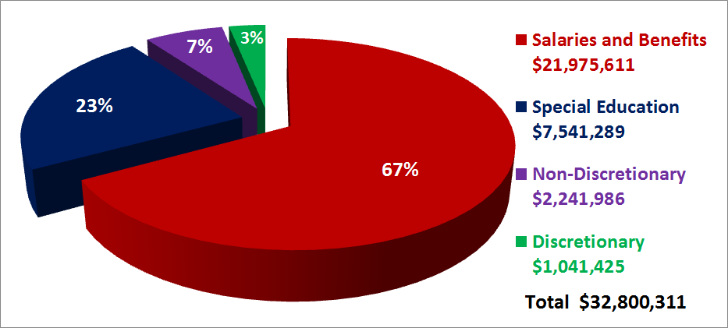
2016-17 PROPOSED EXPENDITURES - $32,800,311

Slide 11
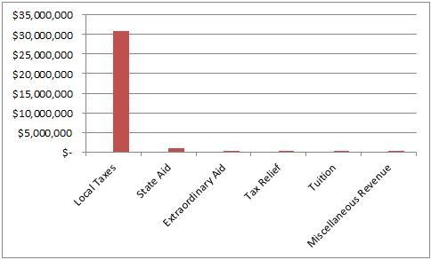
Revenue
2016 / 2017 PRELIMINARY
Local Taxes: $30,966,400 94.41%
State Aid: $916,688 2.79%
Extraordinary Aid: $250,000 0.76%
Tax Relief: $221,329 0.67%
Tuition: $185,894 0.57%
Miscellaneous Revenue: $260,000 0.79%

Slide 12
Five-Year Summary
 |  | 2011-2012 ACTUAL | 2015-2016 ADOPTED | 2016-2017 ADOPTED | 1-YEAR CHANGE | 5 YEAR CAGR Compounded Annual Growth Rate
SALARIES |  | $15,872,819 | $16,948,076 | $16,926,851 | -.07% | 1.29%
BENEFITS |  | $4,401,244 | $4,747,272 | $5,048,760 | .95% | 2.78%
SPECIAL EDUCATION |  | $5,733,184 | $7,033,097 | $7,541,289 | 1.60% | 5.64%
NON-DISCRETIONARY (professional development, curriculum writing, custodial and maint. supplies) |  | $1,823,522 | $1,932,998 | $2,241,986 | .97% | 4.22%
DISCRETIONARY (regular classroom and co-curricular supplies) |  | $801,460 | $1,174,349 | $1,041,425 | -.42% | 5.38%
TOTAL |  | $28,632,229 | $31,835,792 | $32,800,311 | 3.03% | 2.76%

Slide 13
Benefit Costs
Cost of health benefit plan. Includes health, dental and vision.
Family $27,360
Husband and Wife $23,064
Parent and child $16,212
Single $10,428
201 staff members carry benefits at a cost of $4,256,096 less employee contribution of approximately $1,000,000
62 staff members opt out and the cost is $300,000
Social security, pension and unemployment costs are approximately $863,925
Workman’s compensation insurance costs are approximately $200,000
Board liability and property insurance costs are approximately $195,519

Slide 14
Non-Discretionary and Discretionary Spending
Non-discretionary
Staff in-service and professional development
Testing
Legal and auditing fees
Liability insurance
Buildings and grounds
Copier and technology leases
Postage
Phones and internet service
Advertising
Office supplies
ESIP lease payment
Discretionary
Classroom supplies
Health supplies
Guidance supplies
Library and audio visual supplies
Athletic and co-curricular supplies
Computer and printer purchases

Slide 15
Comparable Districts
SCHOOL DISTRICTS | TOTAL SPENDING PER PUPIL | CLASSROOM SUPPLIES | EXTRA- CURRICULAR | AVG. PROPERTY TAXES
BERKELEY HEIGHTS TWP | 15,709 | 215 | 580 | 12,195
CALDWELL-WEST CALDWELL | 14,290 | 344 | 491 | 10,145
GLEN RIDGE BORO | 14,583 | 479 | 525 | 18,569
KINNELON BORO | 15,665 | 324 | 568 | 13,706
MADISON BORO | 15,153 | 311 | 595 | 12,338
MAHWAH TWP | 17,509 | 240 | 524 | 8,154
NEW PROVIDENCE BORO | 13,234 | 350 | 478 | 13,364
RAMSEY BORO | 17,723 | 243 | 461 | 11,829
VERONA BORO | 13,131 (1st lowest) | 338 (6th lowest) | 452 (1st lowest) | 10,791 (4th lowest)

Slide 16
2015 VERONA HIGH SCHOOL COLLEGE ACCEPTANCES
The University of Alabama Albright College American University Amherst College Arcadia University Arizona State University University of Arizona Babson College Bard College Belmont Abbey College Bennington College Bentley University Bergen Community College Berkeley College Binghamton University Bloomsburg University Boston College Boston University Brandeis University Brookdale Community College Brown University Bryant University Bucknell University Caldwell University Univ. of California/Berkeley Univ. of California/Santa Cruz Carnegie Mellon University Case Western Reserve Univ. The Catholic University of America Centenary College College of Charleston Christopher Newport Univ. Clark University Coastal Carolina University Colgate University University of Colorado Colorado State University Columbia University University of Connecticut Cornell University County College of Morris Curry College | University of Dayton University of Delaware Delaware Valley College University of Denver DeSales University Dickinson College Drew University Drexel University Eastern Carolina University Elon University Emerson College Emory University University of Edinburgh Endicott College Essex County College Fairfield University Fairleigh Dickinson University Fashion Institute of Technology Felician College Fordham University Franklin Pierce University The George Washington Univ. Georgetown University Georgia Institute of Technology Georgia State University Georgian Court University Gettysburg College Global College at LIU Goucher College Grinnell College Hamilton College Hampshire College University of Hartford Harvard University High Point University Hofstra University Howard University Immaculata University Indiana University Iona College Ithaca College James Madison University Johns Hopkins University | Johnson & Wales University Juniata Collee Kean University Kent State University Kutztown University Lafayette College Lawrence Technological Univ. Lehigh University Liberty University LIM College Long Island University Louisiana State University Loyola University Lynchburg College University of Maine Manhattan College Marshall University Marist College University of Mary Washington University of Maryland Marymount Manhattan College Marywood University University of Massachusetts McDaniel College Mercy College Merrimack College Messiah College Miami University, Oxford University of Miami Michigan State University Michigan Technological University University of Michigan Middlebury College University of Minnesota Mississippi State University University of Mississippi Monmouth University Montclair State University Moravian College Mount Saint Mary College Muhlenberg College New England College University of New Hampshire | University of New Haven New Jersey Institute of Technology The College of New Jersey New York Institute of technology New York University Univ. of N. Carolina/Chapel Hill North Point Bible College Northeastern University Northwestern University Ocean County Community College Old Dominion University Pace University Pennsylvania State University University of Pennsylvania Philadelphia University University of Pittsburgh Pratt Institute Princeton University Providence College Purdue University Quinnipiac University Ramapo College Reed College Rensselaer Polytechnic Institute University of Rhode Island University of Richmond Rider University Rochester Institute of Technology University of Rochester Roger Williams University Rollins College Rose Hulman Institute of Technology Rowan University Rutgers University Sacred Heart University Saint Francis University Saint Joseph’s University University of Saint Joseph Saint Peter’s University Salisbury University Salve Regina University San Diego State University University of Scranton | Seton Hall University Siena College Skidmore College Smith College University of South Carolina Southern Connecticut State University University of Southern Maine St. John’s University St. Lawrence University St. Thomas Aquinas College Stevens Institute of Technology Stockton University Stonehill College SUNY College Susquehanna University Syracuse University University of Tampa Temple University Texas Tech Tulane University The New School - Eugene Lang College The Ohio State University Towson University University of Buffalo University of Vermont Villanova University Virginia Tech University of Virginia University of Utah West Chester University West Essex College West Virginia University Western Connecticut State Univ. Western New England University College of William and Mary William Paterson University University of Wisconsin Worcester Polytechnic Institute Xavier University Yale University York College

